Slide 1
Visual Studio Mobile Center

Slide 2
Building an App with Azure Wifi: MSFTGUEST Pw: msevent42pz

Slide 3
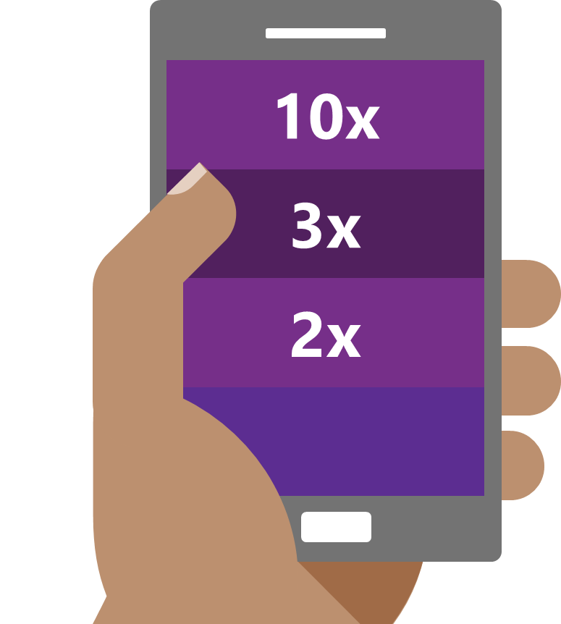
The Need : Mobile has happened
Faster than the PC boom of the 80s
Faster than the recent social networking explosion
Faster than the Internet boom of the 90s
Source: Flurry Analytics (link)
Notes:
The revolution will not be televised – it will be mobile. is not “coming” or “under way”, it has already happened!
And the mobile tidal wave proved to be faster and bigger than anything that came before it.
Mobile is a key part of our customers' digital transformation.
Aside from consumer apps, organizations are mobilizing their workforce and partners with a growing number of critical business apps.
The lower consumer price point of technology has made it ubiquitous – not just in the US – but in the world. In Kenya – they have leapfrogged

Slide 4
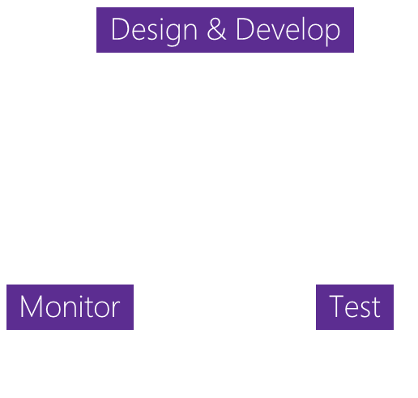


The Challenge: App development challenges
SCALE
COMPLEXITY
FRAGMENTATION
Design & Develop
Monitor
Test
100+ apps
Businesses need to rapidly build and deliver high-quality mobile apps
App Delivery
The lifecycle to deliver ‘just one’ app involves many stages
1000+ Devices
Mobile ecosystems are complex with many combinations of devices
Notes:
In todays world, many businesses have already started built their first initial apps, typically targeting mobile devices, whether for internal use or customer facing. Soon 1 app turns to 10, or 100, as they being to realize that in order to be successful and thrive in todays market they will have to support not just one mobile app but a multi-app mobile strategy.
We call this concept the appification of your business. As one app turns to many, in introduces greater complexity in the development process as you try to iterate, develop and maintain this suite of apps.
Finally, app development is difficult, as you have to target a large number of device configurations to reach your audience.

Slide 5






HockeyApp
Xamarin Test Cloud
Xamarin Insights
Distribution • Crashes • Analytics
Device Tests
Crashes • Analytics
Visual Studio Mobile Center
Azure Mobile Engagement
Azure App Service
CodePush
Analytics • Push
Tables • Auth • Push
Distribution
Notes:
Talk about how our teams and product came together.
We’ve taken these Microsoft products which are leading services in their specific part of the mobile development lifecycle and we’ve brought it all together. Into Visual Studio Mobile Center. A mission control for all your apps. A place where all these service seamlessly integrate to make the cycle easier and faster for developers. Developers of all kinds regardless of which platforms their developing for. The value of Mobile Center is reaching developers who aren’t our typical Microsoft customers by providing the highest quality services in the smoothest configuration. We’re giving them an end-to-end solution where they can use all of it or pick what they want, all while driving Azure attachment.

Slide 6
Visual Studio Mobile Center
Continuous everything
Crash Reporting
Live Update
Push Notifications
Notes:
Key points:
This is why we’ve built Mobile Center – your mission control for apps
Mobile Center has everything you need to build great mobile apps, fast
You get the time and the insights to focus on what users want

Slide 7
Visual Studio Mobile Center
Automate entire app lifecycle
Flexible, open platform and modular SDKs
Support for Obj-C, Swift, Java, React Native, and Xamarin apps
A mobile-optimized front door for Azure App Service
The next generation of Xamarin Test Cloud, HockeyApp, and CodePush
Notes:
In just a few minutes, you can connect your apps to complete set of lifecycle services: continuous integration, automated testing, distribution, engagement, crash reporting, and analytics, as well as a mobile-optimized front door into Azure cloud services.
The upshot? Release higher quality apps faster. Build quality into the process by embedding automated UI tests into your build and release pipeline, then get integrated crash and analytics data on your apps in the wild. So you can spend more time on apps and less time on opps. Focus on innovation
And we don’t want to displace things that already work for you. We work with iOS, Android, and UWP apps written with Objective-C, Swift, Java, React Native, or Xamarin. If you don’t want to use the whole Mobile Center suite right now, you can pick just the services you want. The platform is completely open and modular, and every feature is available through an API.

Slide 8
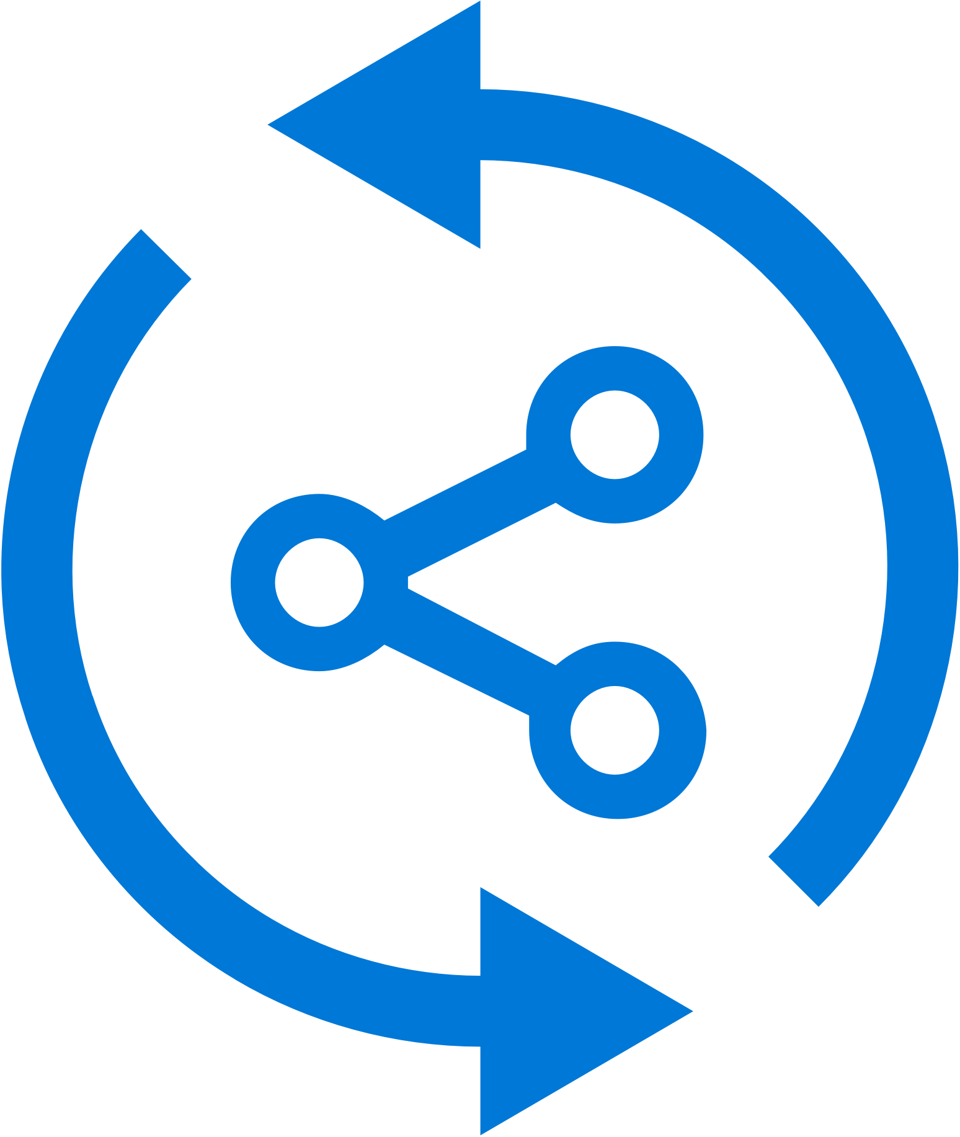


Continuous Everything: Build
Build-on-push
With just a few steps automatically build apps with every commit, and generate packages to test and distribute
Work with existing tools
Connect existing repositories in GitHub, Bitbucket, and Visual Studio Team Services with just a few clicks
Build securely in the cloud
Each build is run on a separate, clean virtual machine hosted on our secure cloud servers
Notes:
The Build functionality allows you to connect your existing code repositories, like VSTS, GitHub and BitBucket and configure them to run automatically on code submission, or on a timed schedule, regularly staying up to date on the health of your build. This is all done on the cloud, so you don’t have to manage any hardware locally.

Slide 9


Continuous Everything : Test
Release faster
Shrink release times significantly and push new apps out faster
Ship high quality apps Ensure the highest quality user experience that keeps users continuously engaged
Engage a broad audience
Test on a broad range of devices to make sure apps work on your users’ devices
Notes:
Along with Build, you App Center also has a device lab with over 300 configurations of Android and iOS devices that you can run your developed UI Automation scripts. We support scripts written in a variety like UITest, Appium or the native Espresso and XCUITest. Run your app on real devices without, again, maintaining the hardware, and getting live results to know your app is bug free.

Slide 10
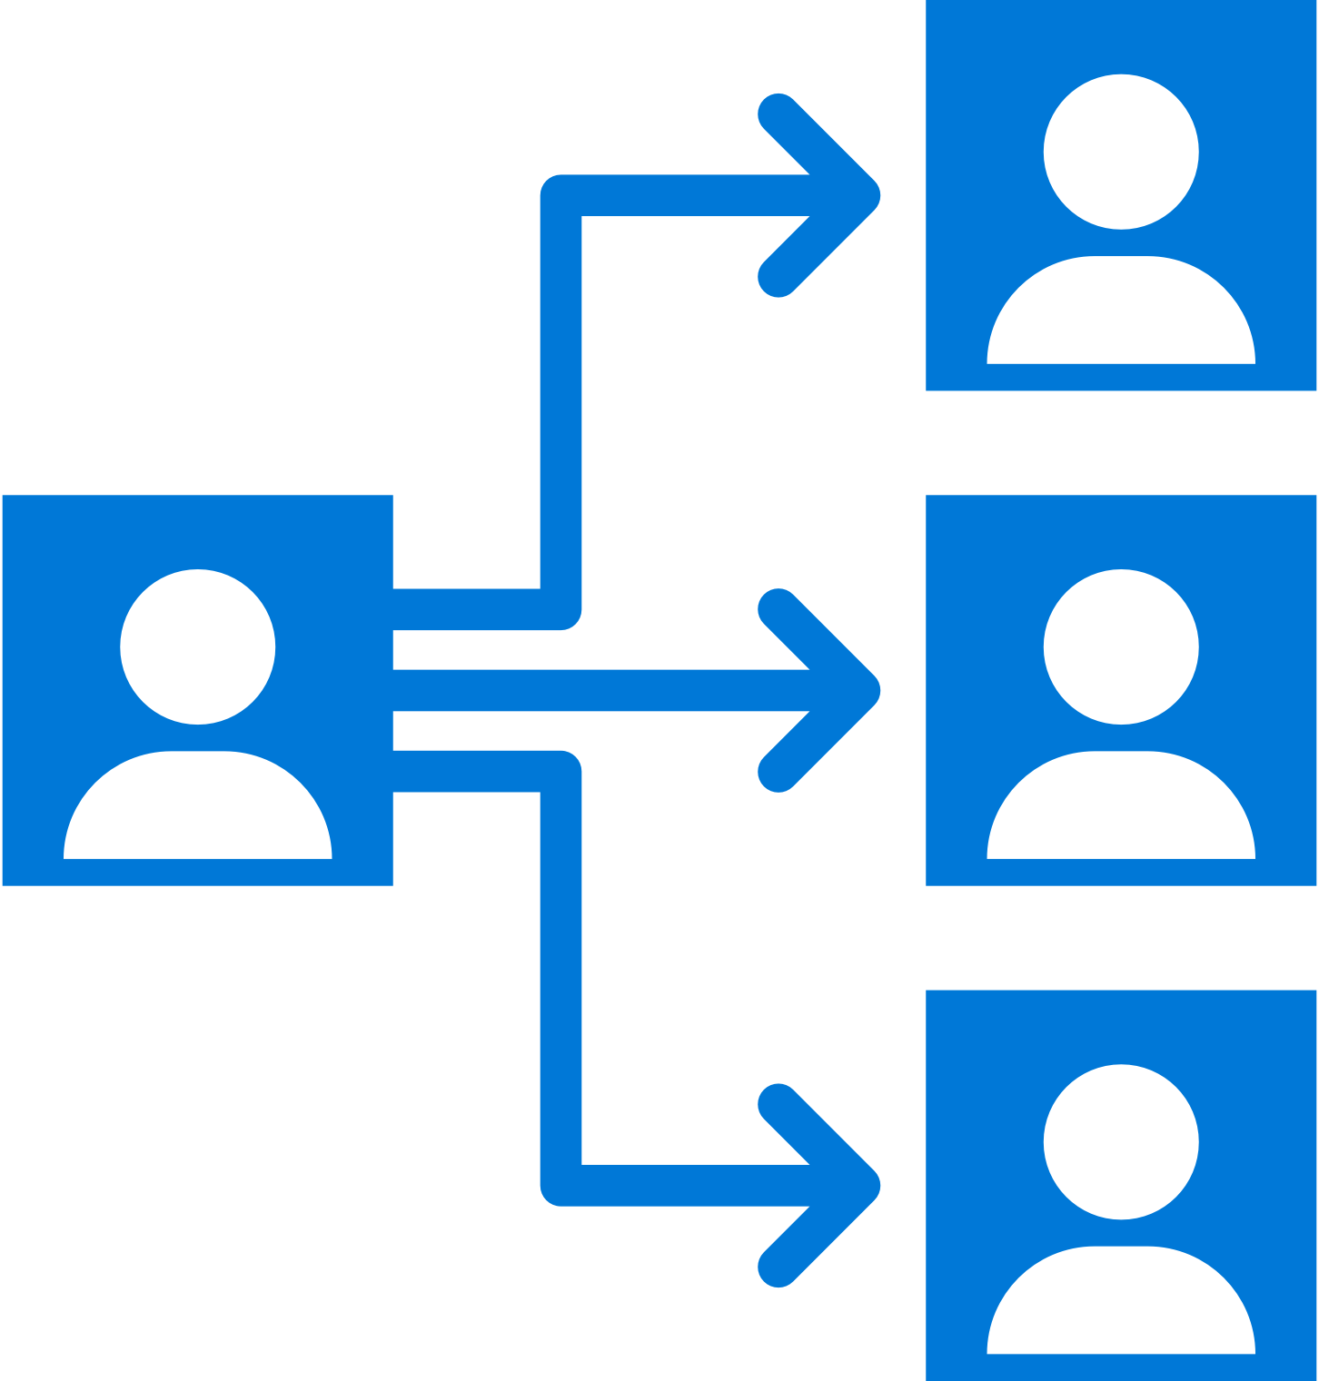

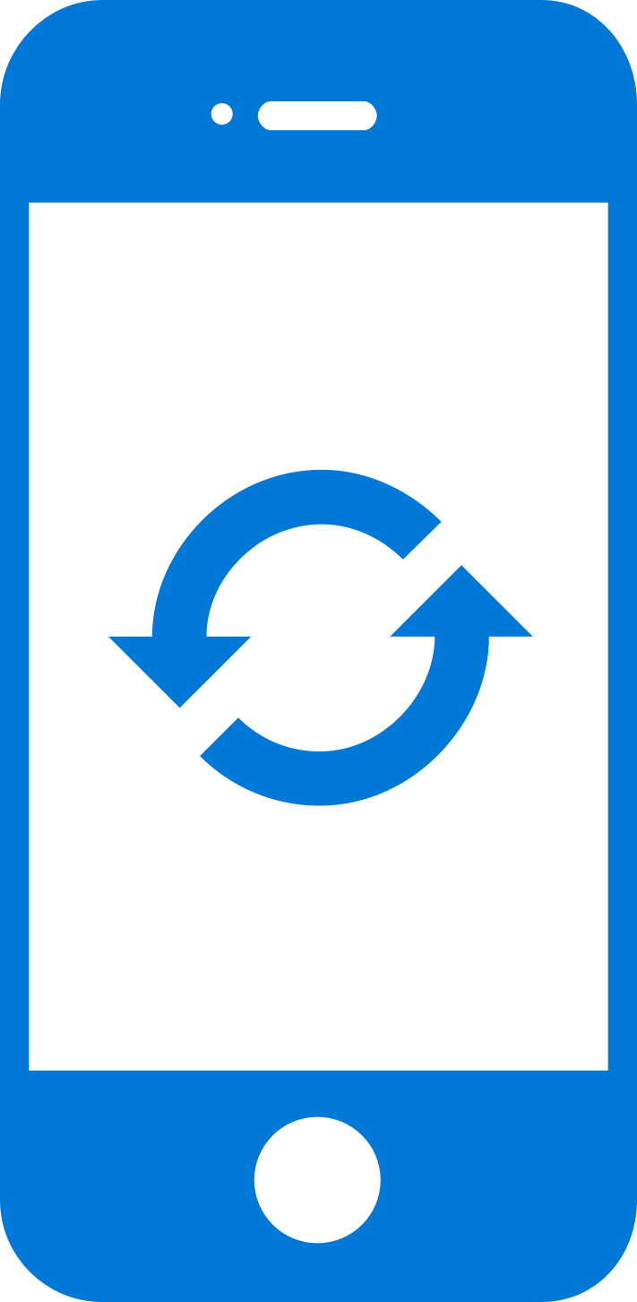
Continuous Everything : Deploy
Instantly distribute apps
Quickly get apps in the hands of your beta testers on multiple device platforms
Create targeted distribution groups
With categorized groups of users, send specific builds to specific groups and devices
Send in-app updates
Notify beta testers as soon as a new build is available, right inside the app
Notes:
Once you have built and tested your app, you probably will want to distribute it to testers at some point. With Mobile Centers distribution offering you can create distribution groups, both for internal private users or public groups and send your app to them for live updates. You also have the ability to publish directly to the public stores like Google Play and Itunes Connect once you are ready to do so.

Slide 11
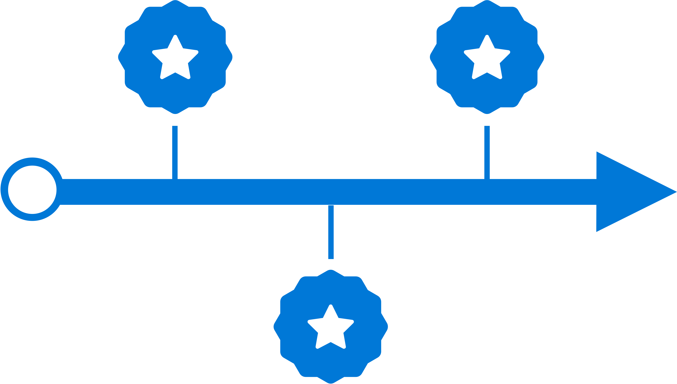


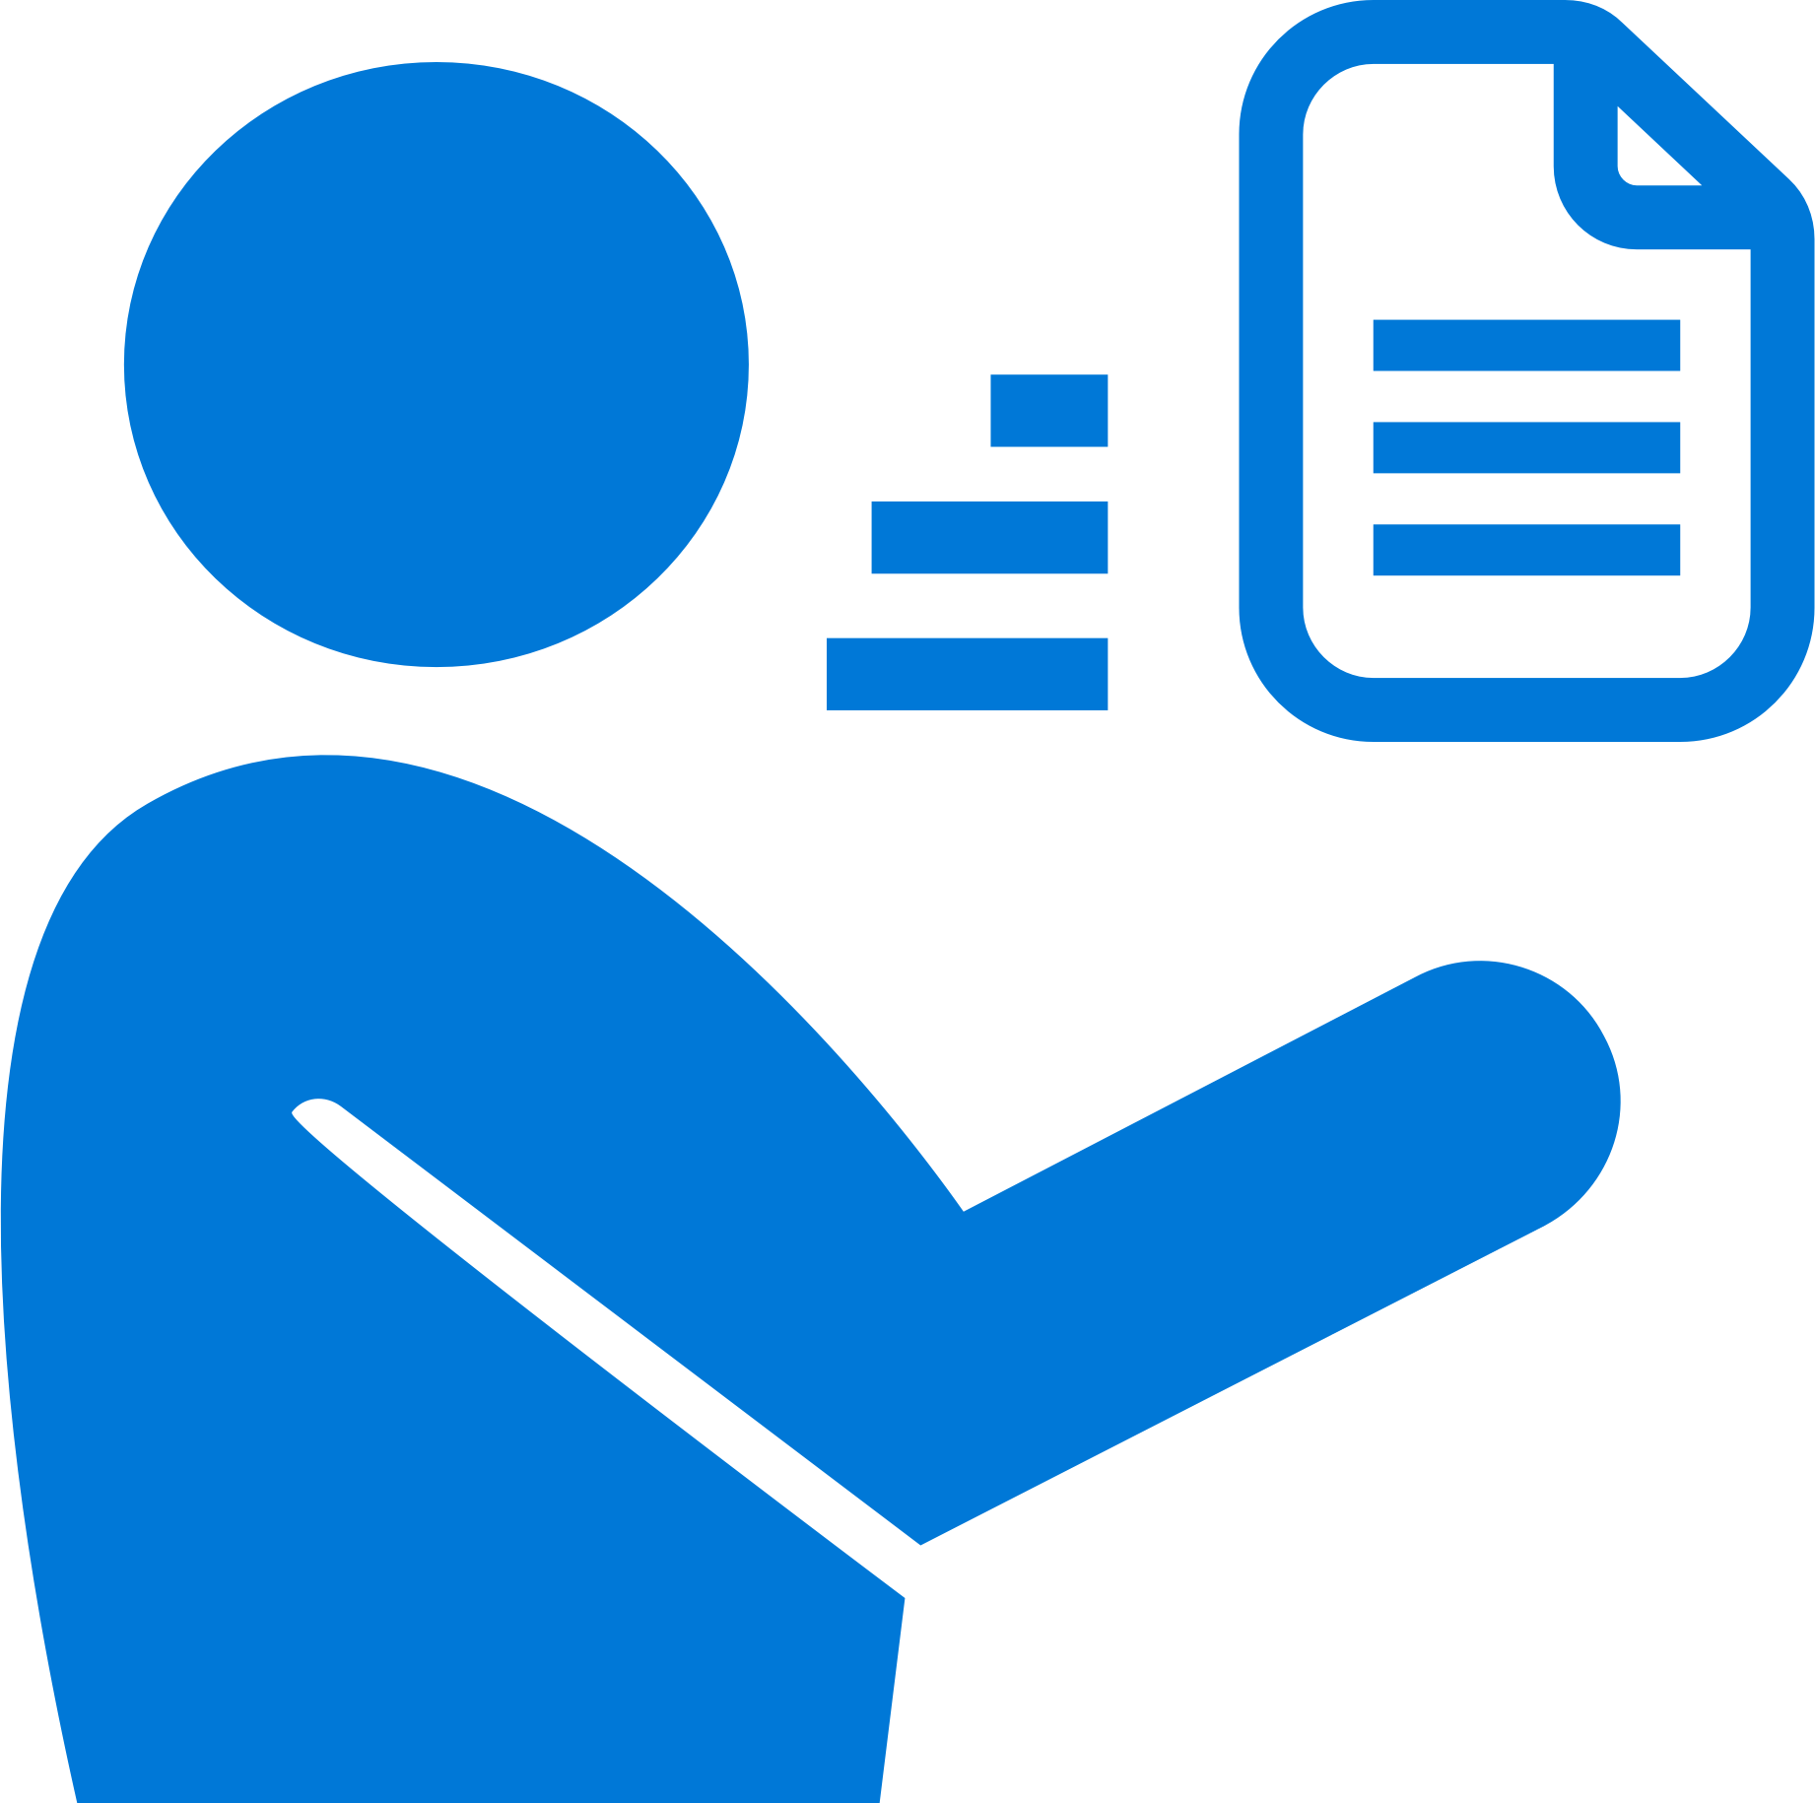
Continuous Everything : Learn
Ship consistent quality
Diagnose crashes fast for maximum uptime and maintain high quality
Get real-time insights
Monitor your app health with real-time crash reports to diagnose and fix problems quickly
Do smart troubleshooting
Crashes are grouped together by similarities to focus on the most critical groups
Easily analyze data
Get detailed, easy-to-read stack traces and logs to quickly understand issues
Notes:
Once your app is live, we, as developers want to continue to know how our app is doing. With our crash service, you can get live stack traces and crash reports from the field, all consolidated in our portal. You will also know details live OS and device type, and crash frequency, and integrate with your bug tracker when crashes occur so you can know and prioritize issues as they arise.

Slide 12
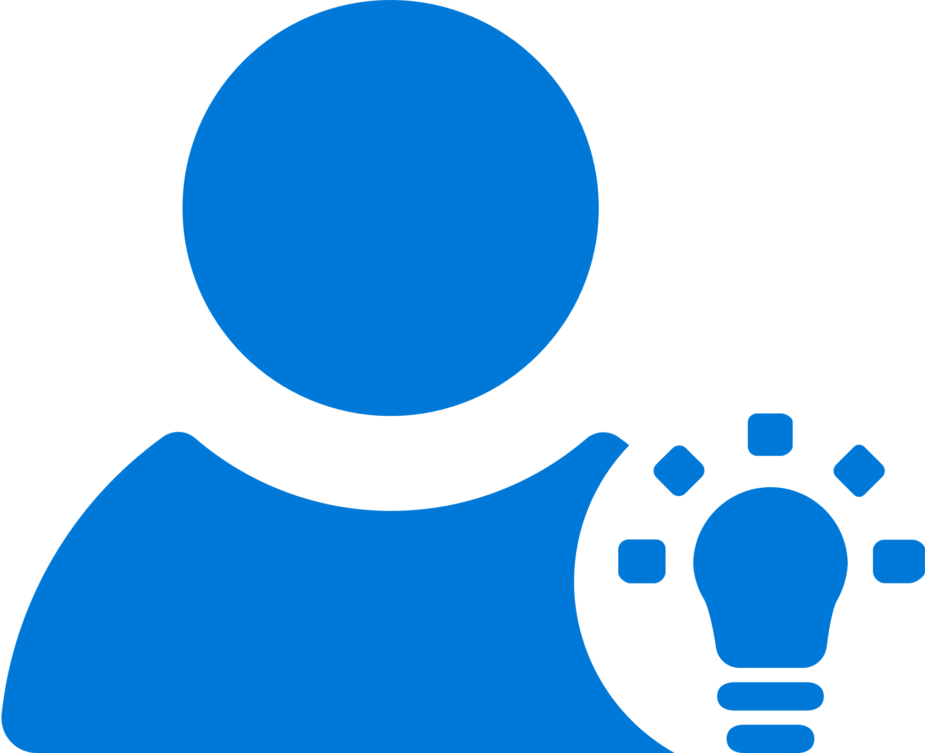
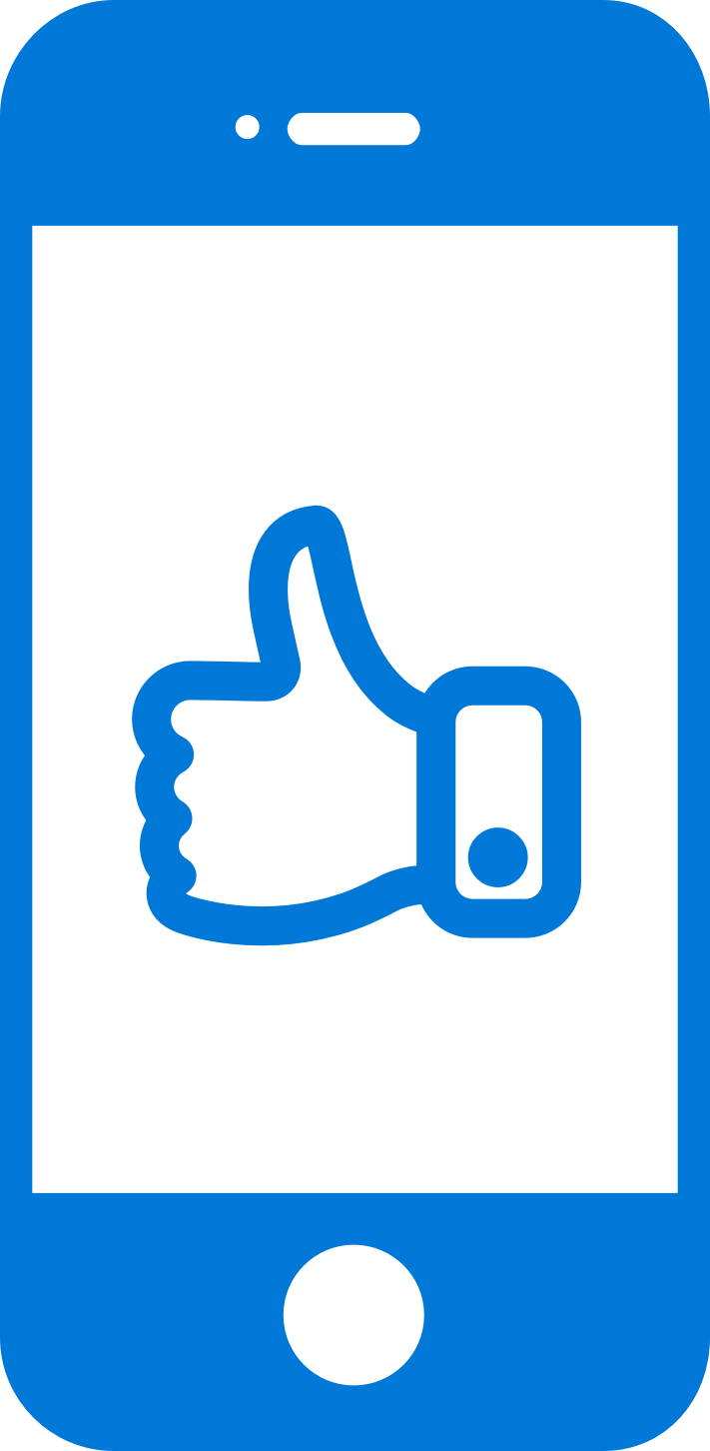


Continuous Everything : Learn
Access instant data
Integrate the analytics SDK in just two steps to start instantaneously seeing data from your app
Understand your customers
Real-time app usage data about your core audience—devices, locations, session info, and more
Build what users want
Analyze the data to see how customers use your app and accordingly prioritize and build new features
Learn more faster
Use custom events to follow users’ actions through your app to analyze their likes and dislikes
Notes:
Along with Crash, many developers want to know more about how their users are engaging with the app. With just a few steps you can start getting immediate information about things like session frequency, adoption rate of releases and even geographic location of your users. All of this can help you learn more and build features your users will love.

Slide 13

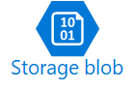
Continuous Everything : Learn
Custom Analtics
Run your own analysis, queries and filtering on your data.
Expanded Storage
Programatically access the raw data, store it indefinitely
Notes:
If you need more from your data, we also support export into both Azure Application Insights and Blob Storage.

Slide 14
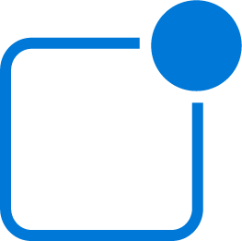
Continuous Everything : Engage
Focused Messaging
Create and send push notifications from a single portal to all app versions
Create Targeted Audiences
Use your Analytics data to create targeted audiences to help tailor messages to specific customers
Notes:
Finally, Mobile Center is also offers support for push notifications. Instead of working through multiple portals to send messages, you can work from a single portal to create targeted audiences and messaging for a more direct connection with your users.

Slide 15
Today’s Agenda
AM
9.30 – 10.30 Setup, Build and Push
10.30 – 10.45 Break
10.45 - 12.00 Testing, Distribution, Analytics and Crash Reporting
PM
12.00 – 1.00 Perficient | Lunch
1.00 – 2.00 Azure Functions
2.00 – 2.15 Break
2.15 – 3.15 Hands on Lab
3.15 – 4.00 Digital Transformation with Azure
4.00 – 5.00 Networking and Prizes

Slide 16

Rob Jewett App. Innovation Specialist Global Black Belt
Notes:
Story: build story have dev team and QA teams in different countries (I’ve worked with customers with teams all over the world)
I don’t have a technical background, and I learned this in a few days, and you can do

Slide 17
Getting Started
Log in to https://mobile.azure.com/
Connect directly with Github, your Microsoft login or new sign-up
Add new App → choose OS/platform
Build:
Select a service
Select Branch
Configure and build
Notes:
How many are Objective C developers?
Java?
React?
Xamarin?
How many of you have tried Mobile Center?
I’ll walk you through getting started, and how to get a build set up
Build: is quick and easy to set up,
Doesn't matter what you use to build your app with (Swift, Java, React Native, Xamarin).
Automatically scans your repo and figures everything out for you.
"Poll of the room who can stand up CI in a week? in a day in am hour.
Docs and APIs link in bottom corner

Slide 18
Mobile Center: Build
Build-on-push
With just a few steps automatically build apps with every commit, and generate packages to test and distribute
Work with existing tools
Connect existing repositories in GitHub, Bitbucket, and Visual Studio Team Services with just a few clicks
Build securely in the cloud
Each build is run on a separate, clean virtual machine hosted on our secure cloud servers
Notes:
Each build is run on a separate, clean virtual machine and no other user has access to this virtual machine. Once the build is completed, the virtual machine is discarded and all files removed. The files resulting from the build (log files, application files, symbol files) are stored on Mobile Center servers.

Slide 19

Mobile Center: Push Notifications
Fast and easy to setup
Just a few lines of code in your app. No need to specify format for iOS, Android and Windows.
Send to specific audiences
Target push notifications to specific users or devices
Fast and easy to send
Three easy steps: Compose, Target, and Review.
No need for technical skills!
Notes:
Visual Studio Mobile Center Push Notifications is really easy
-Just a few lines of code in your app
-No need to specify format for Android, iOS or Windows
-and I’ll show you how easy it is to target and send notifications to your users
Difference in Push Notifications between Notification Hub and MC

Slide 20


Mobile Center: Push Notifications
push
Push notification services
(Apple and Google)
push
push
Notification
Hubs
Visual Studio
Mobile Center
tokens
Notes:
How many of you are involved in mobile app dev?
How many of your apps have push notifications?
Big point of your mobile apps are to engage user and customers. Push notifications helps do that.

Slide 21
June Cho Enterprise Mobile App Dev App Innovation | Global Black Belt

Slide 22
Why Test on Real Devices?
Verify App Integrity
UI loads as expected on different sized screen
App performs as expected on different CPUs
Accessible UI
Features work as per User Flows
Useable Functionality
Testing as part of CI
Reliable Development Cycle

Slide 23
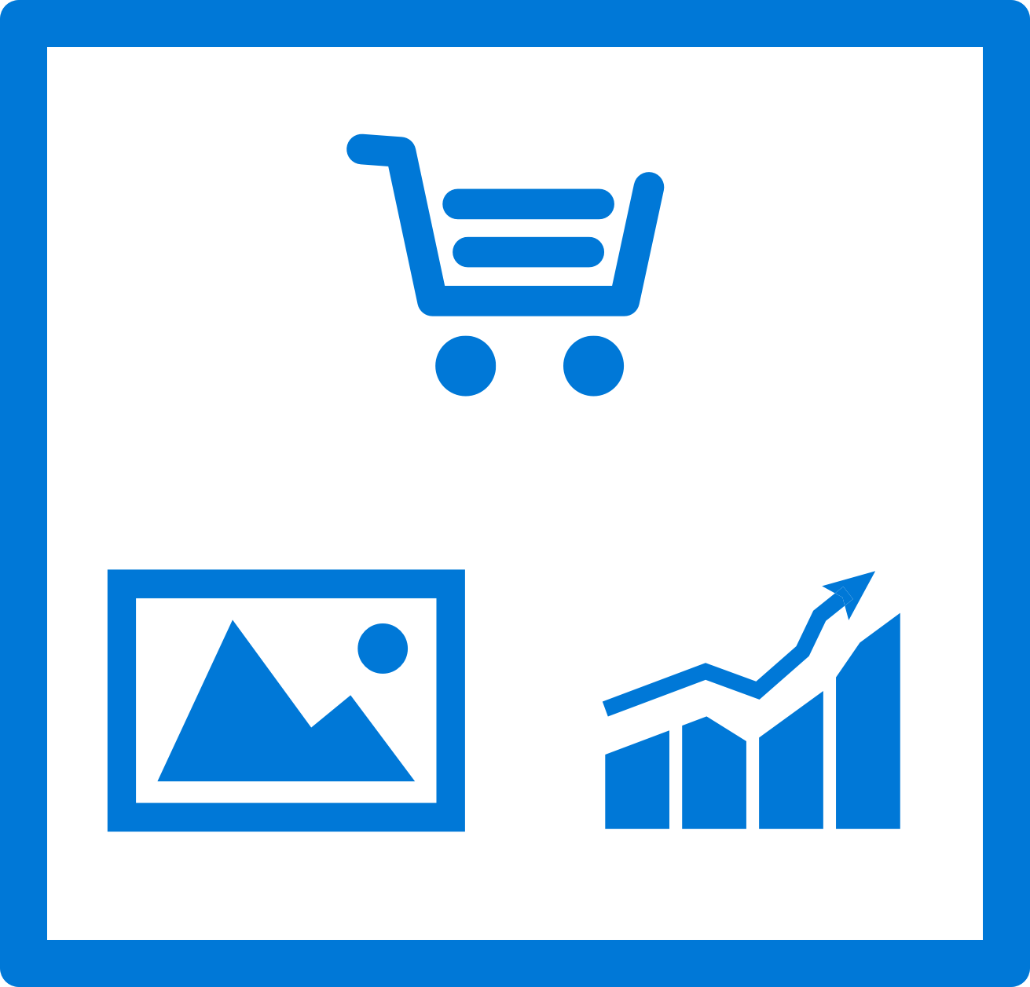
Mobile Center: Test
Release faster
Shrink release times significantly and push new apps out faster
Ship high quality apps Ensure the highest quality user experience that keeps users continuously engaged
Engage a broad audience
Test on a broad range of devices to make sure apps work on your users’ devices
Create new features Spend less time fixing bugs, and more time creating value

Slide 24
Supported Testing Platforms
Xamarin.UITest
Tests written in C#
Supports Xamarin apps, Native (Android, iOS) Apps, React Native Apps, Hybrid Apps
XCUITest
Tests written in Swift
Supports native iOS apps
Espresso
Tests written in Java
Supports native Android apps
Appium
Tests written in Java
Supports native (Android and iOS) apps , Xamarin Apps, React Native Apps, Hybrid Apps

Slide 25
Mobile Center: Distribute
Instantly distribute apps
Quickly get apps in the hands of your beta testers on multiple device platforms
Create targeted distribution groups
With categorized groups of users, send specific builds to specific groups and devices
Send in-app updates
Notify beta testers as soon as a new build is available, right inside the app

Slide 26
Getting Started
Distributing with Mobile Center is easy, and only requires a few steps:
Add users to grant access to all releases.
Create Distribution Groups to manage access.
Upload a new application release.
Install the release onto your device by clicking on the link in the email.
Enable In-App Updates to help your users stay always on the latest release.

Slide 27
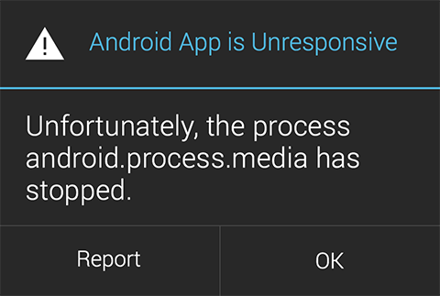
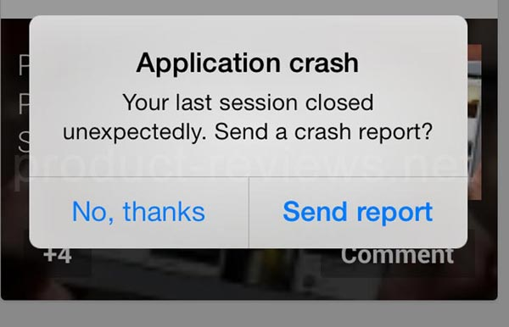

Slide 28
Mobile Center: Crashes
Ship consistent quality
Diagnose crashes fast for maximum uptime and maintain high quality
Get real-time insights
Monitor your app health with real-time crash reports to diagnose and fix problems quickly
Do smart troubleshooting
Crashes are grouped together by similarities to focus on the most critical groups
Easily analyze data
Get detailed, easy-to-read stack traces and logs to quickly understand issues

Slide 29
Mobile Center: Analytics
Access instant data
Integrate the analytics SDK in just two steps to start instantaneously seeing data from your app
Understand your customers
Real-time app usage data about your core audience—devices, locations, session info, and more
Build what users want
Analyze the data to see how customers use your app and accordingly prioritize and build new features
Learn more faster
Use custom events to follow users’ actions through your app to analyze their likes and dislikes

Slide 30
Key Features
Overview
Custom Events
Log Flow
Export to Azure

Slide 31
Sign up free today: mobile.azure.com

